Slide 1









My Number Interactive Notebook
$$×$$
$$\frac{1}{2}$$
$$÷$$
$$+$$
$$−$$
$$\frac{3}{5}$$
$$7$$
Name
Class
Teacher
Term 1 Semester 1
$$5^{2}$$
$$\sqrt{9}$$
1

Slide 2
Contents
Glossary or Formula Page
Page
Date
Description
2
3

Slide 3
Tasks
24
7
30
Essential Question
Questions
Notes
Summary

Slide 4
24
7
30
Date
Percentages
EQ – How do I calculate percentages of amounts with a calculator?
How do I convert a percentage to a decimal?
Percentge → Decimal - divide by 100

Slide 5
Task - Copy and Complete
Percentage | Decimal
12%
33%
68%
83%
20%
6%
130%
12.5%
156%
0.5%

Slide 6
Task - Copy and Complete
Percentage | Decimal
12% | 0.12
33% | 0.33
68% | 0.68
83% | 0.83
20% | 0.2
6% | 0.06
130% | 1.3
12.5% | 0.125
156% | 1.56
0.5% | 0.005

Slide 7
24
7
30
Date
Percentages
EQ – How do I calculate percentages of amounts with a calculator?
How do I convert a percentage to a decimal?
Percentge → Decimal - divide by 100
How do I calulate the percentage of an amount?

Slide 8
24
7
30
Date
Percentages
EQ – How do I calculate percentages of amounts with a calculator?
How do I convert a percentage to a decimal?
Percentage → Decimal - divide by 100
How do I calculate the percentage of an amount?
Write the percentage as a decimal.
The multiply this by the amount.

Slide 9
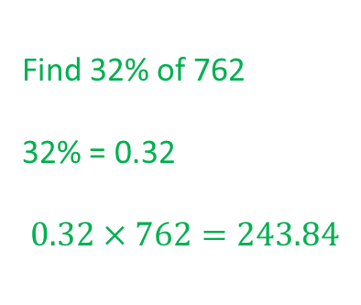
24
7
30
Date
Percentages
EQ – How do I calculate percentages of amounts with a calculator?
How do I convert a percentage to a decimal?
Percentage → Decimal - divide by 100
How do I calculate the percentage of an amount?
Write the percentage as a decimal.
The multiply this by the amount.
Find 32% of 762
32% = 0.32
$$0.32×762=243.84$$
Example

Slide 10

24
7
30
Date
Percentages
EQ – How do I calculate percentages of amounts with a calculator?
How do I convert a percentage to a decimal?
Percentage → Decimal - divide by 100
How do I calculate the percentage of an amount?
Write the percentage as a decimal.
The multiply this by the amount.
Find 32% of 762
32% = 0.32
$$0.32×762=243.84$$
Example
or $\frac{32}{100}×762=243.84$

Slide 11
Task - Copy and Complete
Question | Working | Answer
12% of 1460
33% of 952
68% of 84
83% of 166
20% of 820kg
6% of $24
130% of $45
12.5% of 56ml
156% of $92.50
0.5% of 720g

Slide 12
Notes Review
24, 7 ,30
Date
Title
Essential question
Notes complete
Notes complete with colour and diagrams
Questions completed
Contents page filed in
Formula page filled in

Slide 13
Homework
Review your notes and write a summary answering the essential question.

